Slide 1
217529- Internet of Things
Unit Number: 5
Unit Name: IOT Design and System Engineering
Unit Outcomes: CO5
Design a Simple IOT system comprising sensors by analyzing the requirements of IoT application.

Slide 2
Syllabus
Discuss IOT requirements
Hardware & software
Study of IOT sensors, Tagging and tracking
Embedded products, IOT design
SIM card technology, IOT connectivity and Managements
IOT security & IOT communication.

Slide 3
Discuss IOT Requirements
Connectivity
a) Wired connectivity
b) Wireless connectivity
c) Cellular connectivity
d) LPWAN
Power
a) Power efficiency
b) Power management
c) Battery life
Security
a) Authentication & access control
b) Encryption c) Secure communication protocols

Slide 4
Discuss IOT Requirements
Scalability
a) Distributed architecture
b) Flexible connectivity
c) Cloud integration
Reliability
a) Network reliability
b) Hardware quality
c) Data integrity
Interoperability
a) Standard and protocols
b) Data formats c) API design d) Testing and certification

Slide 5
Discuss IOT Requirements
Data Analytics
a) Data collection
b) Preprocessing
c) Analysis
d) Visualization
Cost effectiveness
a) ROI analysis
b) Scalability
c) Energy efficiency d) Maintenance support
Sustainability
a) Energy efficiency
b) Life cycle assessment c) Material & Manufacturing d) Smart resource Management

Slide 6
IoT Hardware
IoT Hardware includes a wide range of devices such as devices for routing, bridges, sensors etc. These IoT devices manage key tasks and functions such as system activation, security, action specifications, communication, and detection of support-specific goals and actions.
IoT Hardware components can vary from low-power boards; single-board processors like the Arduino Uno which are basically smaller boards that are plugged into mainboards to improve and increase its functionality by bringing out specific functions or features (such as GPS, light and heat sensors, or interactive displays).
Network devices like Bridge, router, switches, repeater etc.

Slide 7
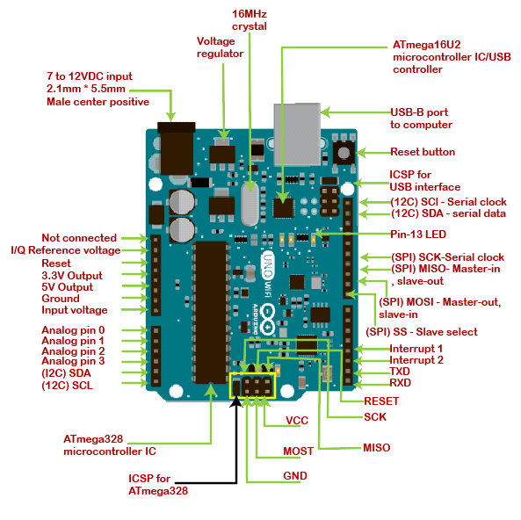
Arduino

Slide 8
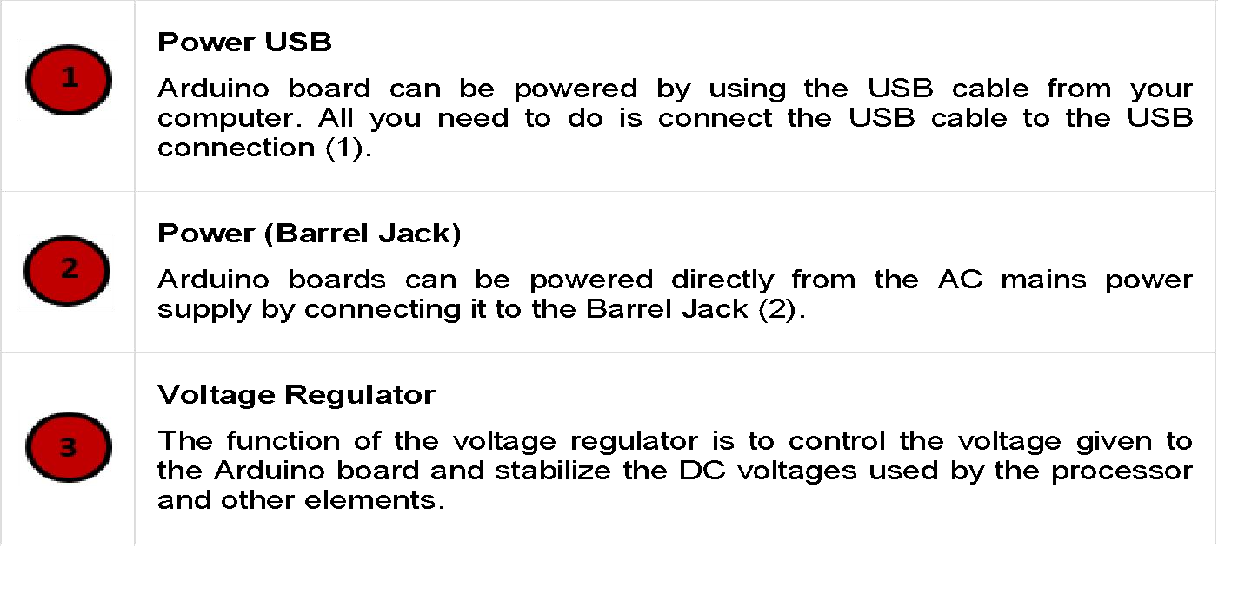
IOT Requirements: Hardware & Software
Internet of Things

Slide 9
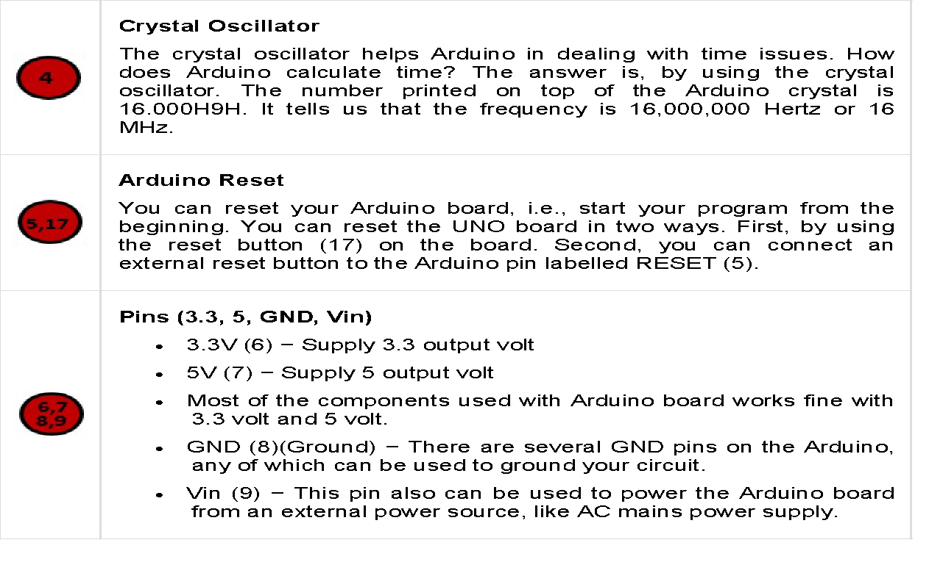
Internet of Things

Slide 10
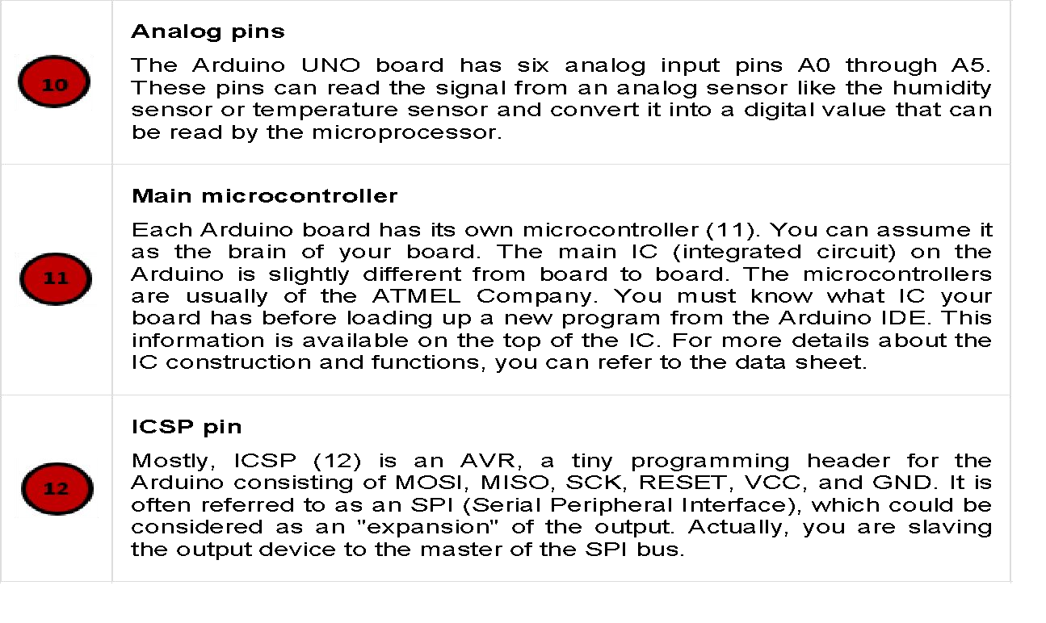
Internet of Things

Slide 11
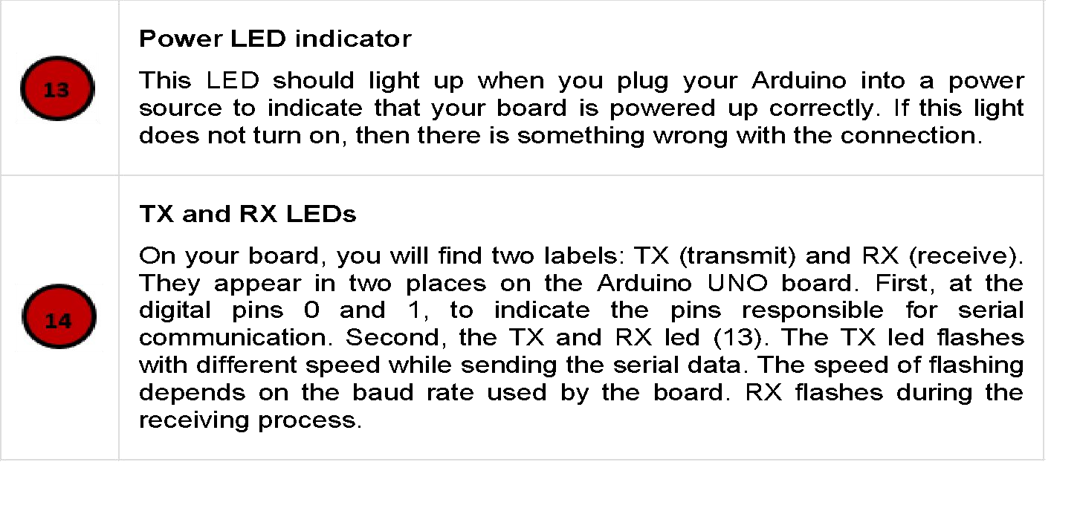
Internet of Things

Slide 12
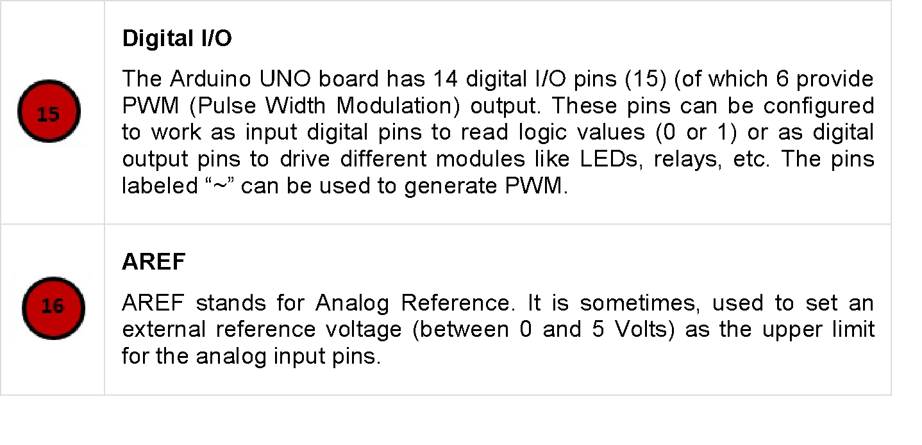
Internet of Things

Slide 13
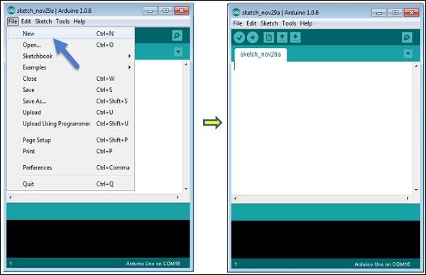
Arduino IDE
Internet of Things

Slide 14
RaspberryPi
Raspberry Pi, developed by Raspberry Pi Foundation in association with Broadcom, is a series of small single-board computers and perhaps the most inspiring computer available today.
Generations and Models
In 2012, the company launched the Raspberry Pi and the current generations of regular Raspberry Pi boards are Zero, 1, 2, 3, and 4.
Generation 1 Raspberry Pi had the following four options − Model A
Model A + Model B Model B +
Among these models, the Raspberry Pi B models are the original credit-card sized format.

Slide 15
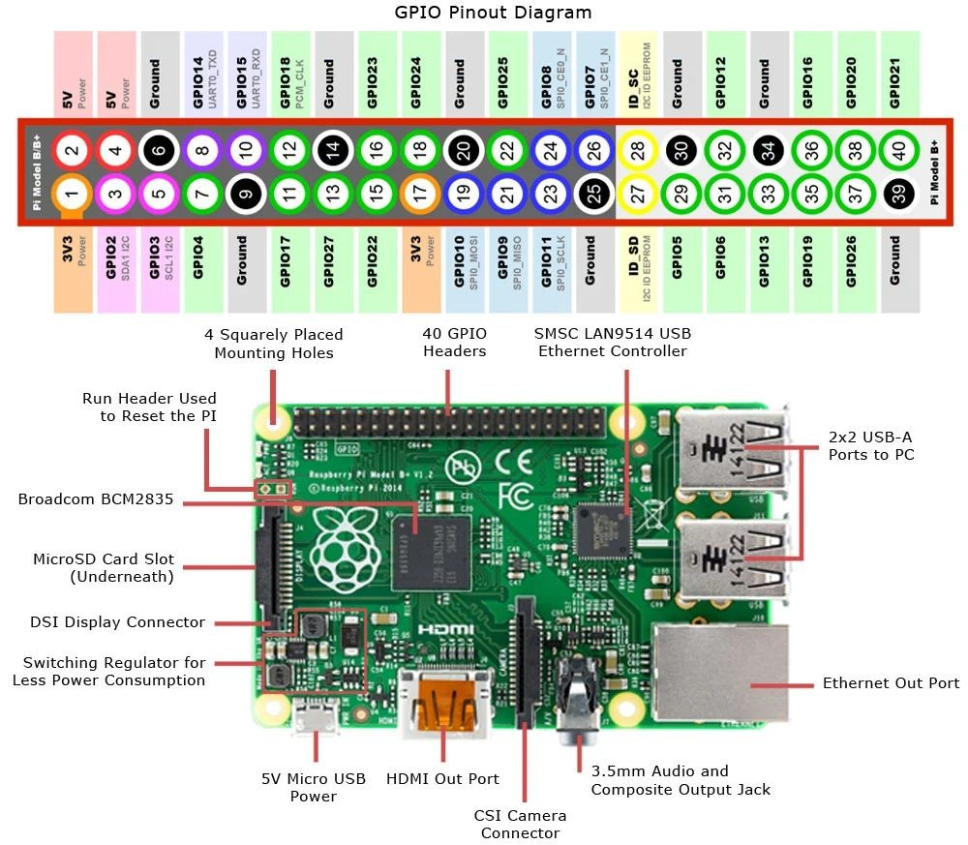
Unit-V : IOT Design and System Engineering

Slide 16
Uses of Raspberry Pi:
Like a desktop computer, you can do almost anything with the Raspberry Pi. You can start
and manage programs with its graphical windows desktop. It also has the shell for accepting text commands.
We can use the Raspberry Pi computer for the following −
✔ Playing games
✔ Browsing the internet
✔ Word processing
✔ Spreadsheets
✔ Editing photos
✔ Paying bills online
✔ Managing your accounts.

Slide 17
Raspbian OS:
Raspbian, a version of a Linux distribution called Debian, is the distribution that is recommended by the Raspberry Pi foundation. It has been optimized for the Raspberry Pi board.
Most of the Raspberry Pi users start with Raspbian and it includes −
Graphical Desktop software.
Web browser.
Development and programming tools like Scratch, Python etc.

Slide 18
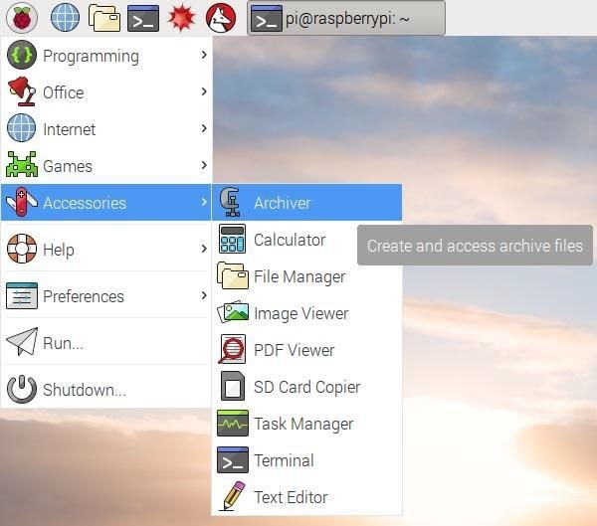
Unit-V : IOT Design and System Engineering

Slide 19
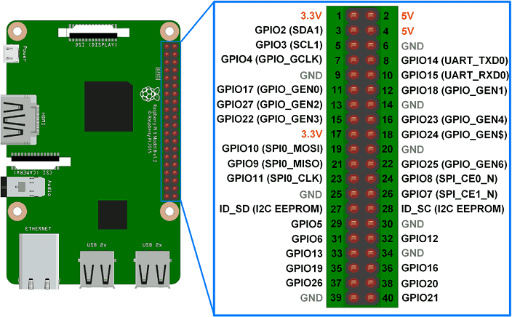
Rasberry Pi

Slide 20
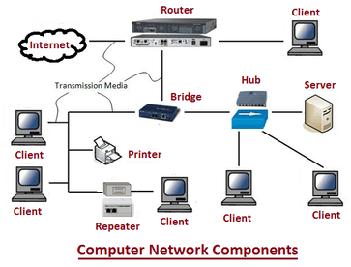

Slide 21
IoT Software
C & C++: The C programming language has its roots in embedded systems—it even got its start for programming telephone switches. It’s pretty ubiquitous, that is, it can be used almost everywhere and many programmers already know it. C++ is the object-oriented version of C, which is a language popular for both the Linux OS and Arduino embedded IoT software systems. These languages were basically written for the hardware systems which makes them so easy to use.
Java: While C and C++ are hardware specific, the code in JAVA is more portable. It is more like a write once and read anywhere language, where you install libraries, invests time in writing codes once and you are good to go.
Python: There has been a recent surge in the number of python users and has now become one of the “go-to” languages in Web development. Its use is slowly spreading to the embedded control and IoT world—specially the Raspberry Pi processor. Python is an interpreted language, which is, easy to read, quick to learn and quick to write. Also, it’s a powerhouse for serving data-heavy applications.
B#: Unlike most of the languages mentioned so far, B# was specifically designed for embedded systems, it’s small and compact and has less memory size.
Data Collection: It is used for data filtering, data security, sensing, and measurement. The protocols aid in decision making by sensing form real-time objects. It can work both ways by collecting data from devices or distributing data to devices. All the data transmits to a central server.
Device Integration: This software ensures that devices bind and connect to networks facilitating information sharing. A stable cooperation and communication ensure between multiple devices.
Real-Time Analytics: In this, the input from users serves as potential data for carrying out real-time analysis, making insights, suggesting recommendations to solve an organizations problems and improve its approach. This, as a result, allows automation and increased productivity.

Slide 22
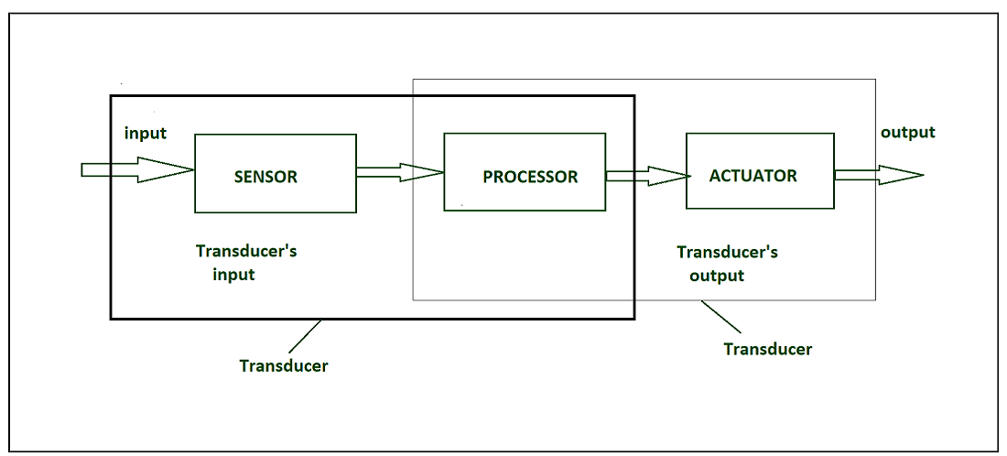
Study Of IOT sensors
IOT Sensors
Sensor Types
a) Passive and Active
b) Analog and digital
c) Scalar and vector
Specification of Sensor
Accuracy
Resolution
Sensitivity
Repeatability
Bandwidth

Slide 23
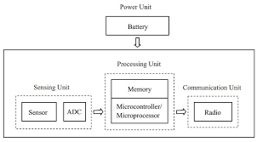
Sensor Components

Slide 24
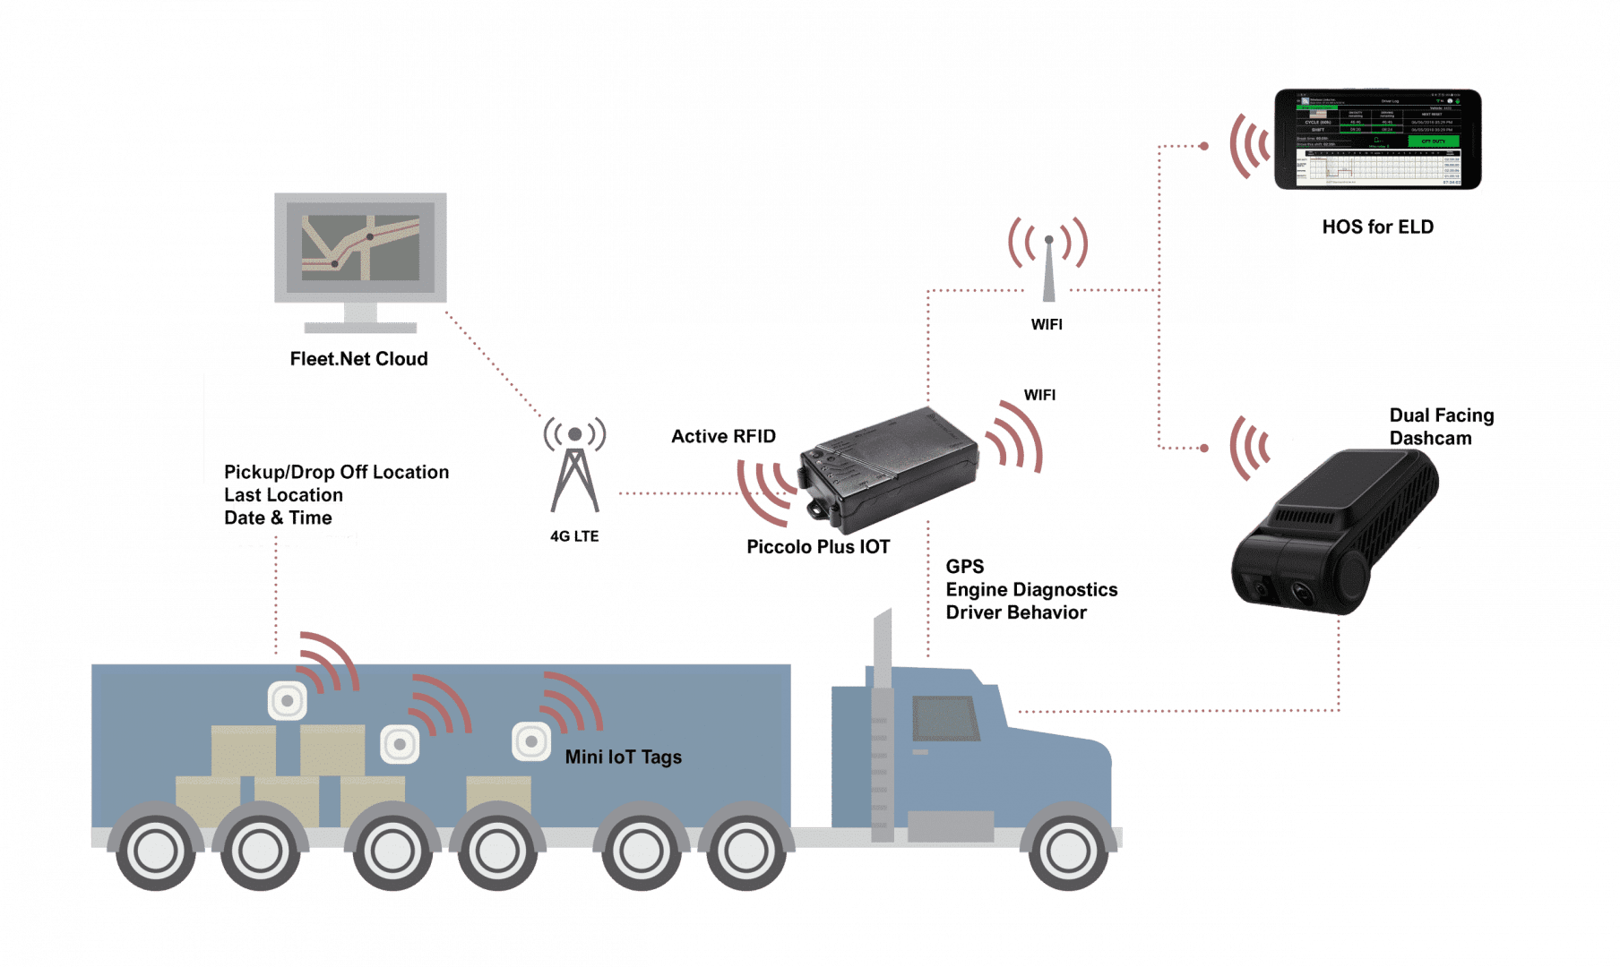
Tagging & Tracking

Slide 25
Tagging and Tracking
IoT tracking and tagging technologies:
✔ RFID tags
✔ BLE Beacons
✔ NFC
✔ Zigbee
✔ LTE Advanced
✔ LiFi
✔ GPS
✔ LPWAN

Slide 26
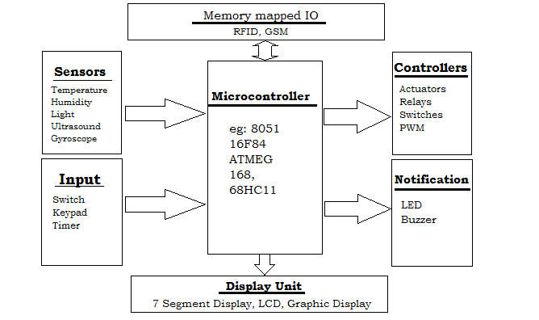
Embedded Products

Slide 27
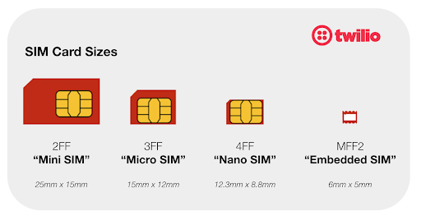
SIM CARD TECHNOLOGY

Slide 28
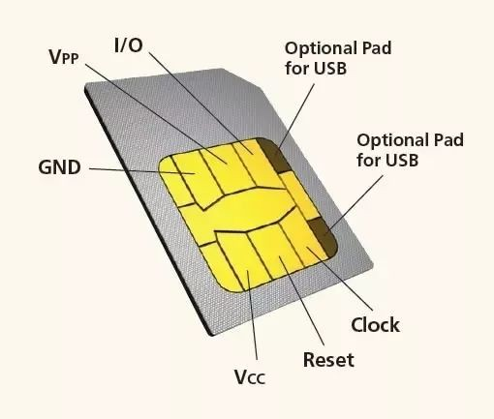

Slide 29
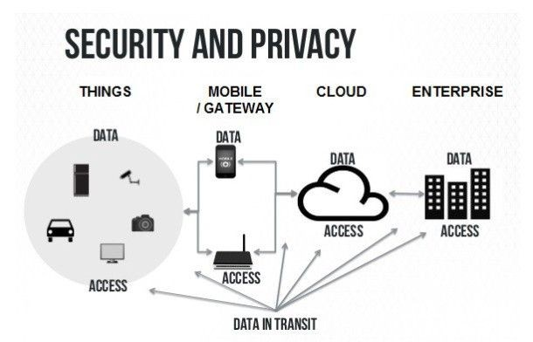

Slide 30
What is IoT security?
IoT security is the practice that keeps your IoT systems safe.
IoT security tools protect from threats and breaches, identify and monitor risks and can help fix vulnerabilities.
IoT security ensures the availability, integrity, and confidentiality of your IoT solution.
Build trust in IoT connected devices
Understanding IoT security risks

Slide 31
IoT Communications
IoT is connection of devices over internet, where these smart devices communicate with each other , exchange data , perform some tasks without any human involvement. These devices are embedded with electronics, software, network and sensors which help in communication.
Types of Communications in IOT :
1. Human to Machine (H2M)
2. M2M
3. Machine to Human (M2H)
4 Human to Human (H2H)

Slide 32
